Slide 1
Forward Kinematics

Slide 2
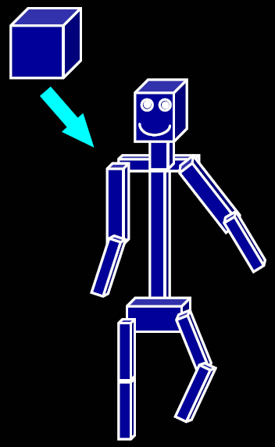
Modeling with Transformations
You have learned everything you need to know to make a stick person out of cubes
Just translate, rotate, and scale each one to get the right size, shape, position, and orientation
Looks great – until you try to make it move

Slide 3
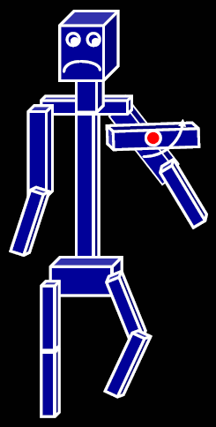
The Right Control Knobs
As soon as you want to change something, the model falls apart
Reason: the thing you’re modeling is constrained but your model doesn’t know it
What we need:
Some sort of representation of structure
A set of “control knobs” (articulation variables) that make it easy to move our stick person through legal configurations
This kind of control is convenient for static models, and vital for animation!
Key is to structure the transformations in the right way: using a hierarchy

Slide 4
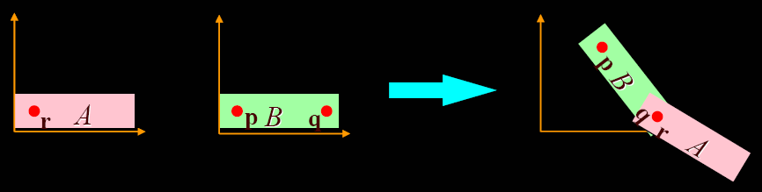
Making an Articulated Model
A minimal 2-D jointed object:
Two pieces, A (“fore arm”) and B (“upper arm”)
Attach point q on B to point r on A (“elbow”)
Desired control knobs:
T: shoulder position (point at which p winds up)
u: shoulder angle (A and B rotate together about p)
v: elbow angle (A rotates about r, which stays attached to q)

Slide 5
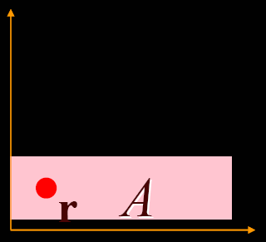
Making an Arm, step 1
Start with A and B in their untransformed configurations (B is hiding behind A)
First apply a series of transformations to A, leaving B where it is…

Slide 6
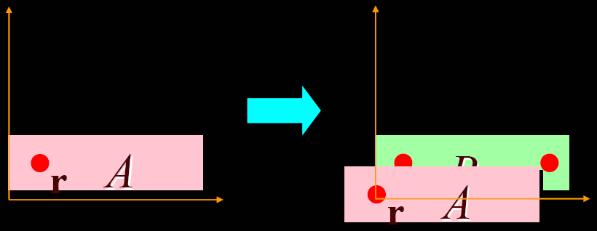
Making an Arm, step 2
Translate by -r, bringing r to the origin
You can now see B peeking out from behind A

Slide 7
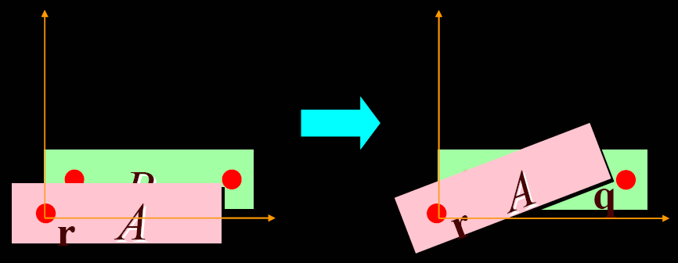
Making an Arm, step 3
Next, we rotate A by v (the “elbow” angle)

Slide 8
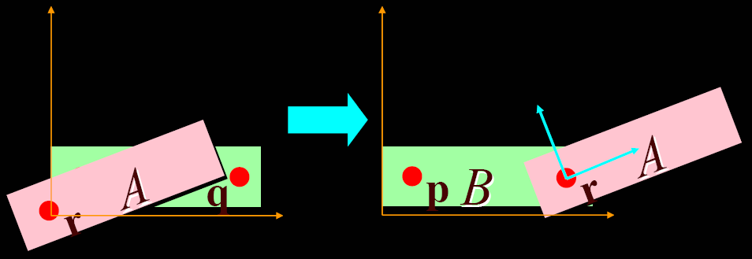
Making an Arm, step 4
Translate A by q, bringing r and q together to form the elbow joint
We can regard q as the origin of the lower arm coordinate system, and regard A as being in this coordinate system

Slide 9
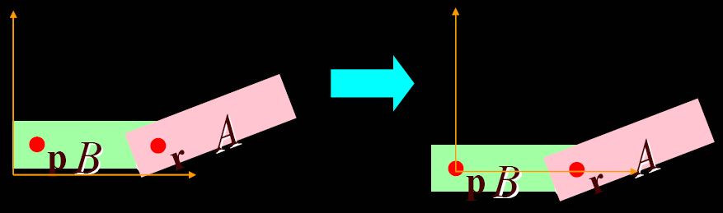
Making an Arm, step 5
From now on, each transformation applies to both A and B (this is important!)
First, translate by -p, bringing p to the origin
A and B both move together, so the elbow doesn’t separate!

Slide 10
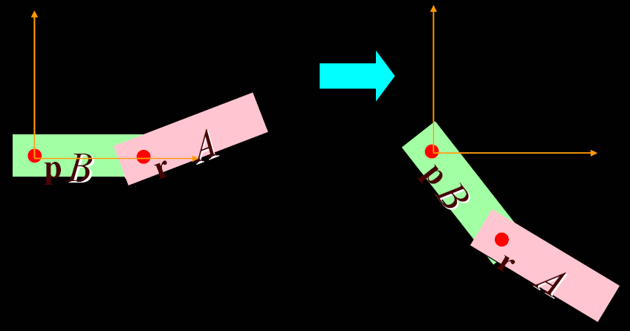
Making an Arm, step 6
Then, we rotate by u, the “shoulder” angle
Again, A and B rotate together

Slide 11
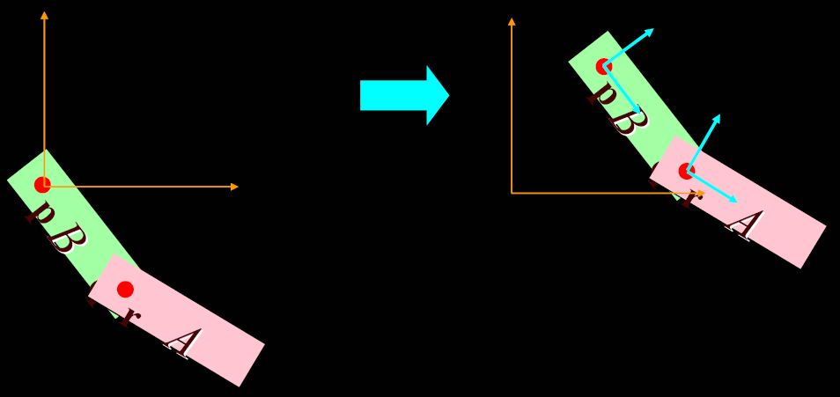
Making an Arm, step 7
Finally, translate by T, bringing the arm where we want it
p is at origin of upper arm coordinate system

Slide 12
What Have We Done?
More complicated than just translating and rotating each piece separately
But the model is easy to modify/animate:
Remember the transformation sequence, and the parameters you used – they are part of the model
Whenever the parameters change, reapply all of the transformations and draw the result
Note:
u, v, and T are parameters (articulation variables) of the model
But p, q, and r are structural constraints
Changing u, v, or T wiggles the arm
Changing p, q, or r dismembers it

Slide 13
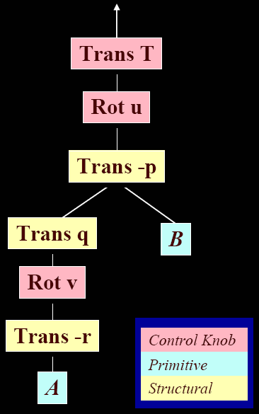
Transformation Hierarchies
This is the build-an-arm sequence, represented as a tree
Interpretation:
Leaves are geometric primitives
Internal nodes are transformations
Transformations apply to everything under them – start at the bottom and work your way up
You can build a wide range of models this way

Slide 14
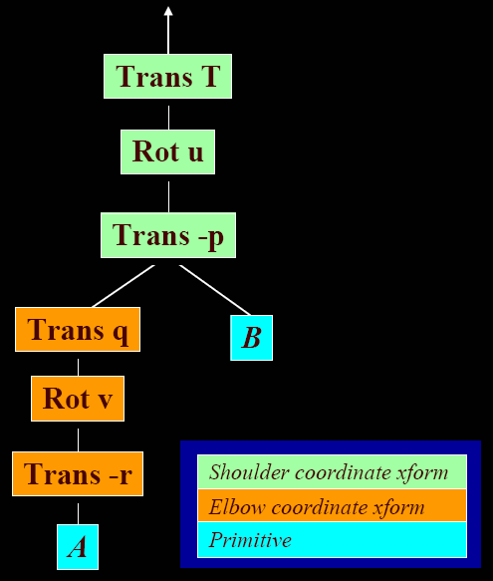
Transformation Hierarchies
Another point of view
The shoulder coordinate transformation moves everything below it with respect to the shoulder:
B
A and its transformation
The elbow coordinate transformation moves A with respect to the shoulder coordinate system

Slide 15
Hierarchical Modeling
Parent-child relationship
Relative motion
Simplifies motion specification
Constrains motion
Reduces dimensionality

Slide 16
Modeling and Animating Hierarchies
3 aspects
Linkages & Joints – the relationships
Data structure – how to represent such a hierarchy
Converting local coordinate frames into global space

Slide 17
Some Terms
Joint – allowed relative motion & parameters
Joint Limits – limit on valid joint angle values
Link – object involved in relative motion
Linkage – entire joint-link hierarchy
Armature – same as linkage
End effector – most distant link in linkage
Articulation variable – parameter of motion associated with joint
Pose – configuration of linkage using given set of joint angles
Pose vector – complete set of joint angles for linkage
Arc – of a tree data structure – corresponds to a joint
Node – of a tree data structure – corresponds to a link

Slide 18
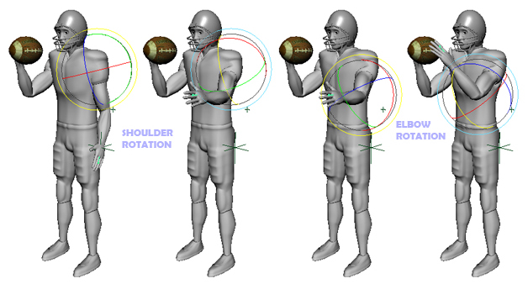
Forward and Inverse Kinematics
Forward Kinematics (FK)
animator specifies values of articulation variables
global transform for each linkage is computed

Slide 19
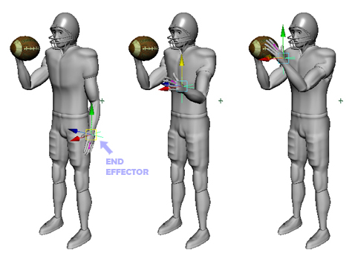
Forward and Inverse Kinematics
Inverse Kinematics (IK)
animator specifies final desired global transform for end effector (and possibly other linkages)
Values of articulation variables are computed

Slide 20
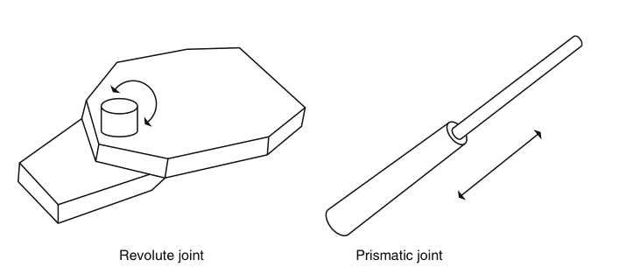
Joints – Relative Movement

Slide 21
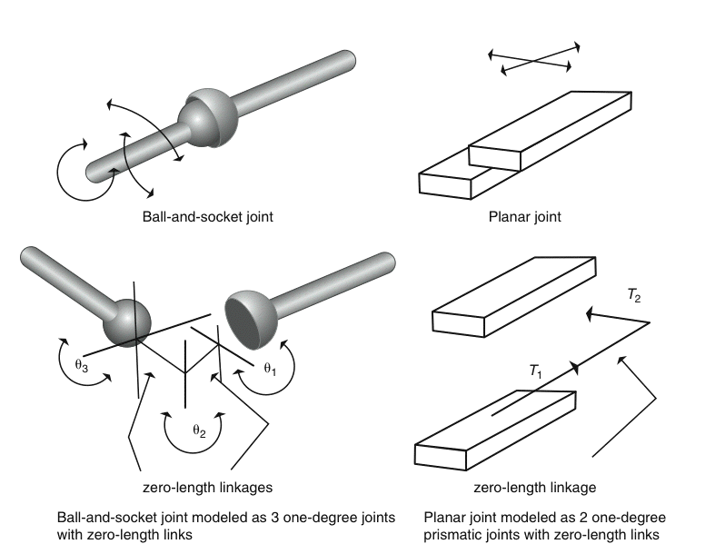

Slide 22
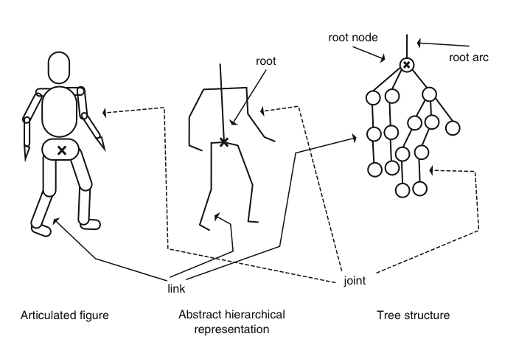
Hierarchical Structure

Slide 23
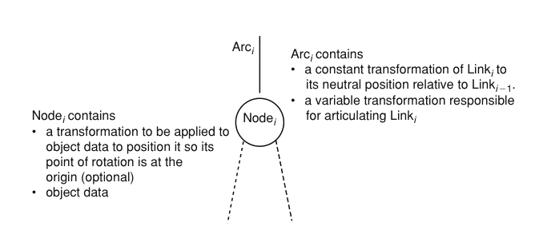
Tree Structure

Slide 24
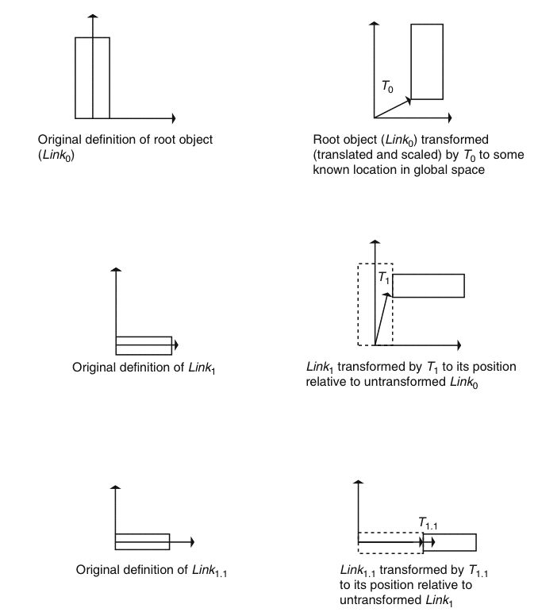
Tree Structure

Slide 25
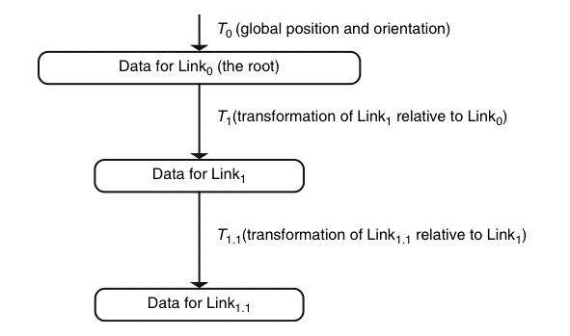
Tree Structure

Slide 26
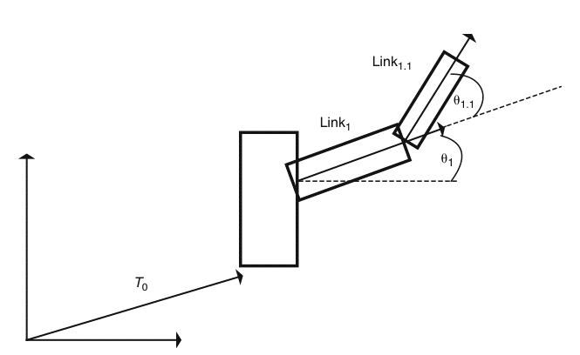
Relative Movement

Slide 27
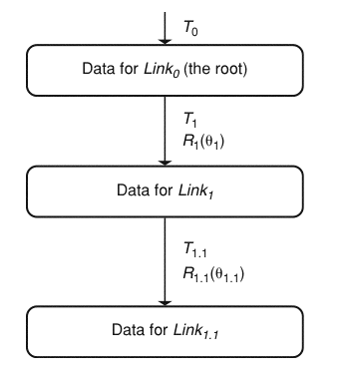
Relative Movement

Slide 28
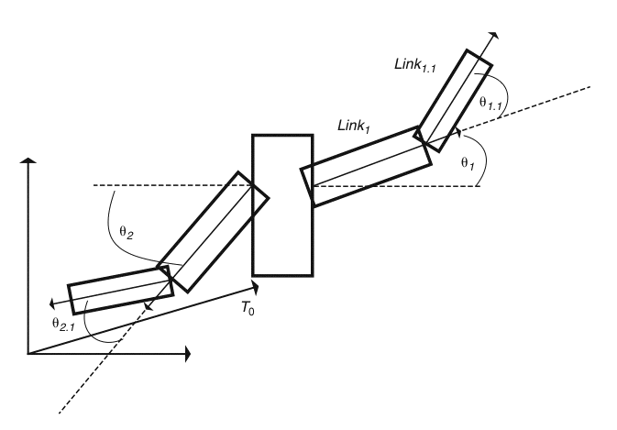
Tree Structure

Slide 29
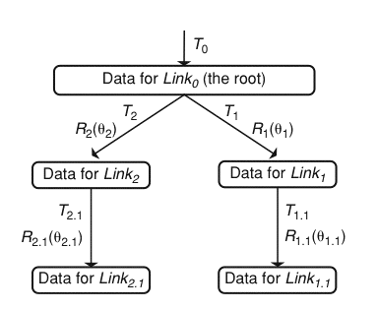
Tree Structure

Slide 30
Implementation Note: Nodes & Arcs
NODE
Pointer to data
Data transformation
Pointer to arcs
ARC
Transform of one next node relative to parent node
Articulation transform
Pointer to node

Slide 31
Implementation Note: Representing arbitrary number of children with fixed-length data structure
Use array of pointers to children
In node, arcPtr[]
Node points to first child
Each child points to sibling
Last sibling points to NULL
In node: arcPtr for 1st child
In arc: arcPtr for sibling

Slide 32
Tree Traversal
traverse (arcPtr,matrix)
{
// concatenate arc matrices
matrix = matrix*arcPtr->Lmatrix
matrix = matrix*arcPtr->Amatrix;
// get node and transform data
nodePtr=acrPtr->nodePtr
//push (matrix)
matrix = matrix * nodePTr->Tmatrix
aData = transformData(matrix,dataPTr)
draw(aData)
//matrix = pop();
// process children
If (nodePtr->arcPtr != NULL) {
nextArcPtr = nodePTr-> arcPtr
while (nextArcPtr != NULL) {
push(matrix)
traverse(nextArcPtr,matrix)
matrix = pop()
nextArcPtr = nextArcPtr->arcPtr
}
}
}
L
A
d,M

